Slide 1
The NYC Taxi CRISIS
Group 7
Haardik Sharma
Harsha Chandar
Madhukiran M
Yogesh Reddy

Slide 2

Does Uber compete with NYC yellow taxis in New York?
Notes:
The NYC Taxi industry is facing both driver and customer churn
Yellow taxis face fierce completion from Uber
Uber has about 25000 new users in NY signing up every week
Taxi owners are in financial crisis owing to large loans taken for buying medallions
They have started to look towards new initiatives to stay competitive
Two apps have been launched – Arro (10,000 downloads) and Way2Ride (4000)
Advantages of NYC Taxi over Uber:
Metered rates
Professional drivers
Regulated environment

Slide 3
Problem Statement
Scenario 1: Direct competition
Uber is causing a decrease in NYC Taxi’s market share
Scenario 2: Increase in overall demand
Uber has contributed to an increase in demand for the taxi industry, thereby leading to an increase in NYC taxi’s demand
Scenario 3: Unmet Demand
Uber is serving the needs of the population that NYC taxi is unable to cater to

Slide 4
PROCESS
Identify demand for NYC taxis in the absence of Uber
Calculate the demand for NYC taxis after the introduction of Uber
Is Uber competing with yellow cabs?

Slide 5

THE DATA
NYC Taxi
Information about the date, time, pick-up and drop locations
Data available from Jan 2009 till Jun 2016
Data size: ~2Gb
Uber
Information about the date, time, pick-up locations
Data available from Apr 2014 till Sep 2014 and from Jan 2015 till Jun 2015
Missing data imputed from Jan 2009 to May 2011 as 0, and 1000 rides distributed equally between May 2011 and Jun 2012

Slide 6
The data
P_DATE | NYC | UBER
Jan-09 | 14092413 | 0
Feb-09 | 13380122 | 0
Mar-09 | 14387371 | 0
Apr-09 | 14294783 | 0
May-09 | 14796313 | 0
Jun-09 | 14184249 | 0
Jul-09 | 13626103 | 0
Aug-09 | 13686520 | 0
New York Taxi Stats
Year | YoY %
2009 | -
2010 | -1%
2011 | 5%
2012 | 1%
2013 | -3%
2014 | -5%

Slide 7
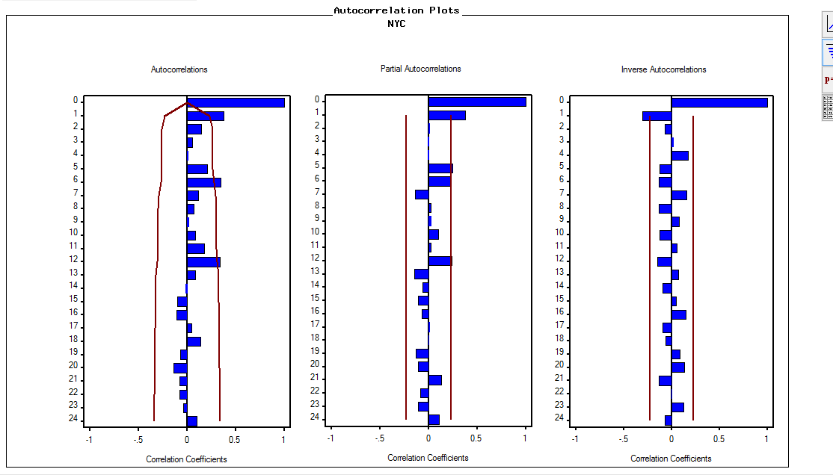
Estimating pre-uber demand for yellow cabs

Slide 8
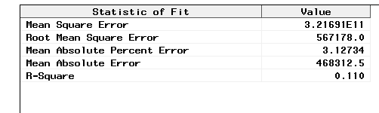
ARIMA (1,1,1)(1,0,0)s MODEL
Training Data: Jan 2009 to Jan 2012
Test Data: Jan 2012 to Dec 2012

Slide 9
PREDICTION RESULTS
Month | Actual | Predicted
Jan-14 | 13782492 | 14454277
Feb-14 | 13063791 | 14261798
Mar-14 | 15428127 | 14404858
Apr-14 | 14618759 | 14621165
May-14 | 14774041 | 14561996
Jun-14 | 13813029 | 14443366
Jul-14 | 13106365 | 14212338
Aug-14 | 12688877 | 13870710
Sep-14 | 13374016 | 14021461
Oct-14 | 14232487 | 14186033
Nov-14 | 13218216 | 14178464
Dec-14 | 13014161 | 13939378
Jan-15 | 12748986 | 13838138
Feb-15 | 12450521 | 13628557
Mar-15 | 13351609 | 13923353
Apr-15 | 13071789 | 13823779
Potential Lost Sales: 9,632,405

Slide 10
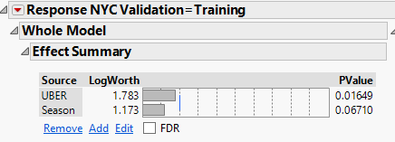
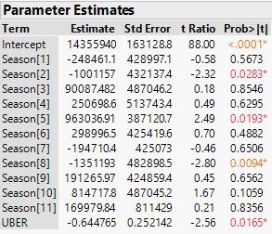
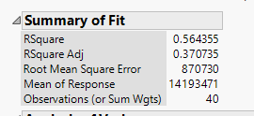
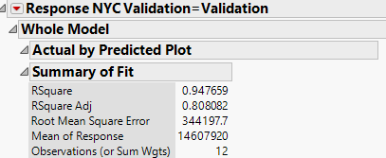
EFFECT OF UBER ON NYC TAXI

Slide 11
NYC VS. UBER – LOCATION ANALYSIS
Timeframe: Sep 2014
Average rides available per 15 minute interval:
NYC: 4
Uber: 1
Average trips by each carrier:
NYC: 69%
Uber: 31%

Slide 12
NYC vs UBER OVER A DAY
Time of day

Slide 13
NYC vs. UBER – TOURIST LOCATIONS

Slide 14
NYC VS UBER – TOURIST LOCATIONS

Slide 15
CONCLUSION
Revise strategy
Promotions
Incentivize app usage
Ensure availability of taxis at all locations at all time intervals

Slide 16
APPENDIX

Slide 17
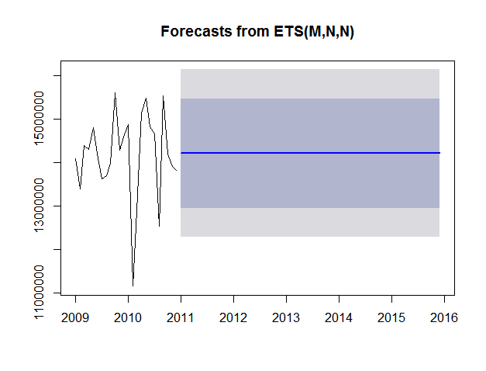
Automatic exponential smoothing

Slide 18
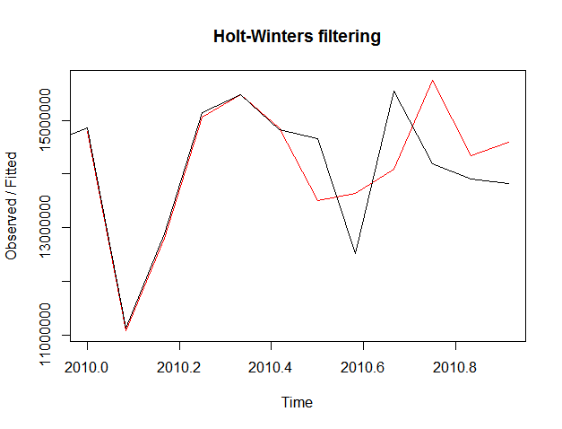
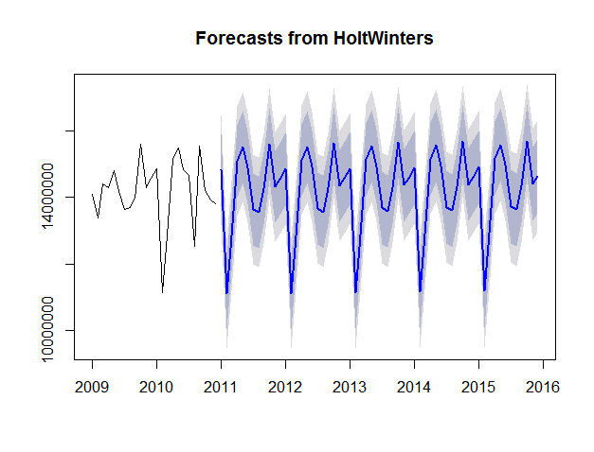
Holtwinters additive model

Slide 19
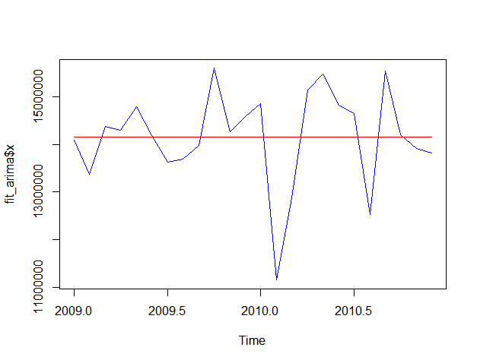
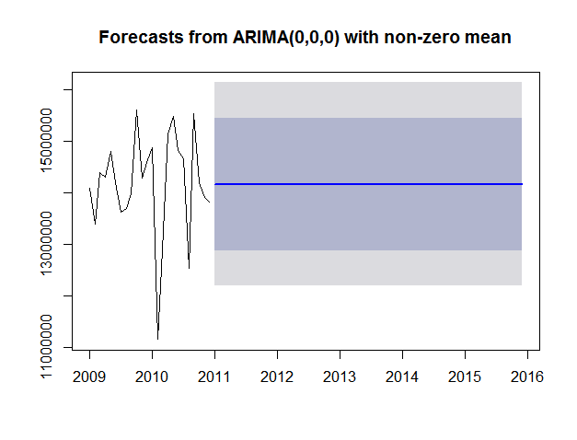
Arima – (0,0,0)

Slide 20
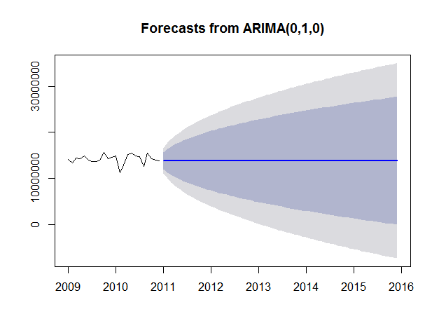
ARIMA -(1,0,0)

